Slide 1
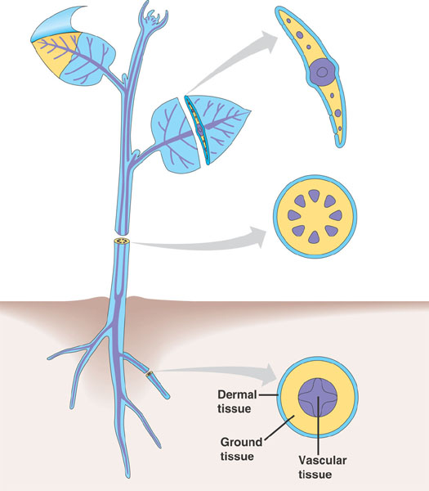
PLANT TISSUES
Plants are made up of a number of tissues that work together.
Vascular tissue conducts food and water from one part of the plant to another.
The tissue for growth are located at the tips of root and stem.

Slide 2
PLANT TISSUES
Depending upon the dividing capacity of the cells, plant tissues can be classified as :
Meristematic tissues
Permanent tissues
Permanent tissues are further classified as :
Mature cells incapable of cell division
Cells capable of cell division
Simple tissues are of 6 types :
Simple
Complex
Complex tissues are of 2 types :
Made up of more than one type of cells
Made up of one type of cells
Parenchyma
Xylem
Chlorenchyma
Phloem
Aerenchyma
Collenchyma
Sclerenchyma
Surface tissue (Epidermis)
Let us study them one by one

